Slide 1
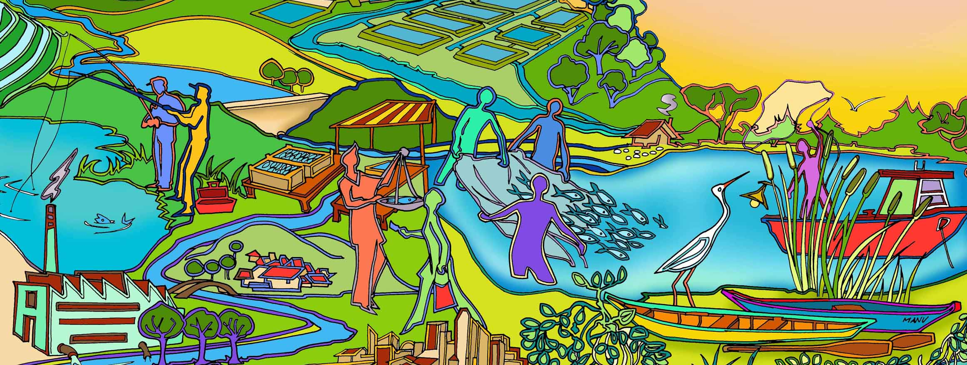
Session 12 Reality check I
Essential EAFm training
Date |Place

Slide 2
Notes:
It is now time for Reality Check I. This done after we have set our goals to see if the goals are really achievable.
Refer to large visual this on wall to keep up as reference throughout course. Show where we are in course.

Slide 3
Session Objectives
After this session you will be able to:
Identify the constraints and opportunities in meeting your FMU goals
Use facilitation skills with co-management partners in focus group discussions (FGDs)
Use conflict management to resolve conflict in EAFm
Notes:
Make sure you PLAN WELL for how to run this session:
Start this session just before lunch on day 3, explaining that to cover various objectives we will be doing lots of people skills practice. Go up to ‘constraints and opportunities’ activity (slide 5) before lunch.
As an energiser after lunch do mapping of FMU conflicts (slide 6).
Next, 30 minutes reviewing facilitation skills through practice of focus group discussions (Slides 7-10).
Have an early afternoon break.
After break: conflict management (slides 11-17) discussion, concepts and role play.

Slide 4
Constraints and Opportunities to Meeting the Goals
For each goal you identified in step 2.3 there will be constraints and opportunities to achieving it
These may include:
insufficient time
lack of human capacity/skills
cost
lack of data and information
lack of political, stakeholder and institutional support
Some of these may have been already included in your threats and issues
Notes:
1st part of Reality Check focuses on constraints and opportunities for achieving FMU goals.
Each goal is reviewed and constraints and opportunities to achieving it.
These constraints may be (i) cost , (ii) lack of political, stakeholder and institutional support, (iii) lack of human capacity and skills, (iv) insufficient time and (v) lack of data and information.

Slide 5
In your groups
Identify the constraints and opportunities to achieving your FMU goals
Output:
constraints on green cards
opportunities on yellow cards
Notes:
The EAFm team needs to be aware of likely constraints and opportunities for planning purposes.
From the general challenges and opportunities you identified for your country in session 5, revisit these thinking about your specific FMU goals. You can take the same cards if you want.
Output: for each FMU, have green constraints and yellow opportunities.
Trainers to ensure these are stuck onto flipcharts as they will be needed on day 4.
Now break for lunch.

Slide 6
In your groups
Revisit your FMU maps and plot
areas where conflicts are likely to occur and
who the players are
Notes:
Keep to 15 minutes maximum.
The session content can then be contextualised; trainer to refer to actual plotted and identified conflicts while explaining slides of more general concepts.
Leave the maps after 15 minutes and focus on FGD activity.

Slide 7
Focus Group Discussions (FGD)
A tool to work with stakeholders to reduce conflict and identify opportunities
Participants need to share experiences, ask questions and develop their own priorities
Role of the facilitator:
Raise and agree on issues
Stimulate discussion and find solutions
Notes:
Reducing conflict and turning constraints into opportunities can be achieved by working with stakeholders. FGD is a basic tool that should be used throughout EAFm cycle, can be useful at all stages, for all stakeholders but particularly useful for solving problems.
Now time to focus on facilitation skills (as part of human resources needed).
30 minutes in total for FGD. We will practice key facilitation skills in focus group discussions (FDGs). These are needed throughout EAFm cycle to involve and engage with multiple stakeholders.
Quickly look at good and bad facilitators drawn earlier.
Refer to People Toolkit tool 5 for how to do FGD, and more detail on limits, issues. Data is not only numerical/ qualitative experience that people voice, but also the actual interactions during the FGD. i.e. the way stakeholders relate to each other is an indication for EAFm.

Slide 8
Facilitator expected to…
Guide each session
Provide structure to discussion
Refocus the discussion as necessary
Guide discussion through a few general questions
Not be too intrusive
Allow everyone to be heard and understood
Allow the discussion to flow freely
If participants do not raise important issues, intervene
Build rapport and trust (use active listening)
Notes:
Referring back to the drawing of a good and a bad facilitator, elaborate on what a good facilitator is expected to do.
Let participants read this slide…
Basic rules:
Thank people for coming
Introduce yourself
Explain aim of FGD, why we want to record session,
Explain format (one person speaks at a time, confidential/ anonymous/ length of discussion agreed)
Facilitator must be aware of sensitive issues, e.g.:
Gender
Controversial
Political
Other...?
Think about WHAT you say and HOW you say it.
Be aware of how issues affect you as a facilitator (how you are perceived/accepted/ listened to....)
Refer to People Toolkit tool 5 for how to do FGD, and more detail on limits, issues.

Slide 9
Activity
Hold a FGD on one topic from next slide. Feedback for all to learn from
Process:
Form groups each with 1 facilitator, 1 observer, others = respondents
Pick one topic (in 30 seconds) then prepare silently for 3 minutes individually
Facilitator to initiate the FGD for the given time
Observer to silently monitor the process
Feedback on the FGD process from observer, facilitator, trainer & others
Notes:
See Session Plan how to run activity in session plan. Ensure you end with reminding/ eliciting from participants at which points EAFm team likely to be using FGDs in the EAFm cycle.
Now have early afternoon break to ensure sufficient time for conflict management session.

Slide 10
FGD Topic Options
EAFm plan exists but there is little political will; government lacks interest; it has not delivered on promises. Suggestions?
The government, fishery officers and police should enforce compliance – do they?
Rules and regulations have been set as a result of the EAFm Plan but one group of stakeholders is not doing what it is supposed to do. Suggestions?
Notes:
Other options: -EAFm sounds ideal but it will be difficult to deal with all conflicting needs.
-It is easy to get communities to participate in fisheries management.
-External enforcement is the only way; self-compliance does not work.
-Engaging fisher communities just means talking to village leaders.

Slide 11
Conflict in EAFm
Many of the constraints and opportunities may involve conflict:
in views and opinions; and
of a more physical nature (fighting)
Where is conflict likely to occur in the EAFm process? (remember your map)
Is conflict always bad?
People tend to resist change; conflict needs to be seen as part of change
Notes:
Conflict management needed to help reduce the constraints and come to agreed positions.
We will now discuss and practise conflict management.
Bullet 2 in slide: have participants review their plotted conflicts on FMU maps + make any amendments.
Share examples as plenary.
Discuss bullet 3- elicit experiences of when conflict not always bad (Think this through beforehand and have some examples of likely conflict situations (usually between stakeholders: conserve the environment vs. fishers; commercial fishing vs. small scale) and how these evolved with positive outcome.
Refer to Participant Handbook Module 12, Figure 12.1

Slide 12
Conflict as Change Process
Denial
Resistance
Acceptance
Commitment
12
Notes:
This is a generic model for process of change. EAFm entails changes to behaviour and thinking for all concerned, so there will be resistance. We need to view this not as a problem but as a necessary step for moving forwards. So do not be afraid of conflict but instead have strategies to mediate it/ prevent it/ even work with it as it can generate options.
Conflict can be expected as part of the EAFm process of change. If the process is well managed, working through the conflict may lead to greater commitment towards the change.
The stages in conflict management are:
Initiation: a stakeholder or outsider invites help to manage the conflict
Preparation: conflict assessment (see section 1 above), information sharing, rules, participant selection
Negotiation: articulating interests and win-win options, packaging desired options
Agreement: concluding jointly on best option package, recording decision making
Implementation: publicising outcomes, signed agreement (optional) , monitoring
Refer to Participant Handbook Module 12, Figure 12.1. Also Figure 12.2 Conflict Strategies and Table 12.1

Slide 13
Conflict Management
WHAT?
A form of facilitated negotiation
HOW?
Apply skills that help people express differences and solve problems for a WIN-WIN outcome
Negotiating
Mediating
Questioning
Listening
Notes:
Ensure we all understand what the 4 terms in colour mean: negotiating, questioning, listening, mediating = all skills that are needed in conflict management. However, need to check participant understanding (also culturally dependent).
Also discuss gender roles: men and women expected to behave in certain ways; what are implications for EAFm process? Same applies to age hierarchy.

Slide 14
Negotiation Strategy
Understand the conflict
who, what, why, etc.
Act as the facilitator
Move towards a win-win outcome
Prepare & analyse
Discuss the options
Propose and seek solutions
Bargain
Notes:
The aim of negotiation is to achieve a WIN-WIN outcome (i.e. an outcome that benefits all parties). The process described here is what participants could go through as part of their role play (see slide 17).
Set the scene: "Let's find a way to solve this that works for everyone“.
Define problem in terms of Needs/Outcomes. Identify stakeholders in the conflict situation. Define original problem and individual needs, as well as expected outcomes. Facilitate parties to define/describe the problem. Identify/analyse root problems and causes. Facilitate parties to define their own needs.
Identify the shared (relationship) needs. Encourage one party to ‘step into the others shoes’
Brainstorm possible solutions. Secure commitment to finding a solution. Identify a range of alternative solutions (actions) and analyse their likely impact (consequences) on both parties (us and them).
Evaluate the solutions
Choose solutions
Plan what action will be taken
Evaluate results
This is process described in Module 12 in a bit more detail.

Slide 15
Powerful Questioning
Ask lots of questions and listen actively to the answers!!
Questions to challenge assumptions
Questions to move forward (get out of stalemates)
Questions to stimulate thinking or convey a vision
Questions to float an idea
Notes:
A good facilitator asks lots of well-directed questions….

Slide 16
Key Messages
In Reality Check I, the constraints and opportunities to achieving the EAFm goals are assessed
Facilitated focus group discussions and conflict resolution can help resolve many constraints
Negotiated win:win outcomes are often possible
Notes:
Self explanatory

Slide 17
‘Win-Win’ Solutions Role Play
In groups:
Read your conflict scenario and decide which role you each will play
Prepare your role (arguments / character) for 5 minutes
Role play the scene
Provide feedback on conflict resolution
Notes:
See details in Session Plan. Achieving win-win solutions role play
Trainer: use role play scenario cards in Trainer Resource Guide (you will need to print and cut these up beforehand). Explain we will do a role play to practise achieving win –win solutions.
1. Divide participants into different groups, distribute different role play scenarios to each group (all scenarios are potential EAFm conflicts)
2. Each group needs: one conflict mediator, one observer, enough of all stakeholder categories listed. So need at least six people per group. Each participant gets a scenario card with THEIR role listed. They know other roles in their group but do not know their motivations. Refer groups to People Toolkit for more on relevant skills to use.
3. Possibly ask all participants to study win-win solution form in Workbook before the role play- so all are familiar with process (but you would need extra time for this)
4. All prepare for five minutes. Trainer to support all the conflict
5. Carry out role plays. Trainers observes and take notes.
6. After the activity, have a debrief/ feedback using tips in the Module and Toolkit. For debrief, follow this sequence: 1st mediator feeds back, then observer, then others in group.
After the activity , do a debrief using tips in Module 12 and in Tool 8 in Toolkit A.

